Slide 1




DIBBs Brown Dog BDFiddle

Slide 2
BDFiddle
Data Transformation Service built for others to build applications around
REST API to program against
Support for many programming languages
Like JSFiddle, BDFiddle is designed to allow users to explore the Brown Dog API through an easy to use web interface and help them get started by providing real code snippets
Source code: https://opensource.ncsa.illinois.edu/bitbucket/projects/BD/repos/bdfiddle/browse

Slide 3
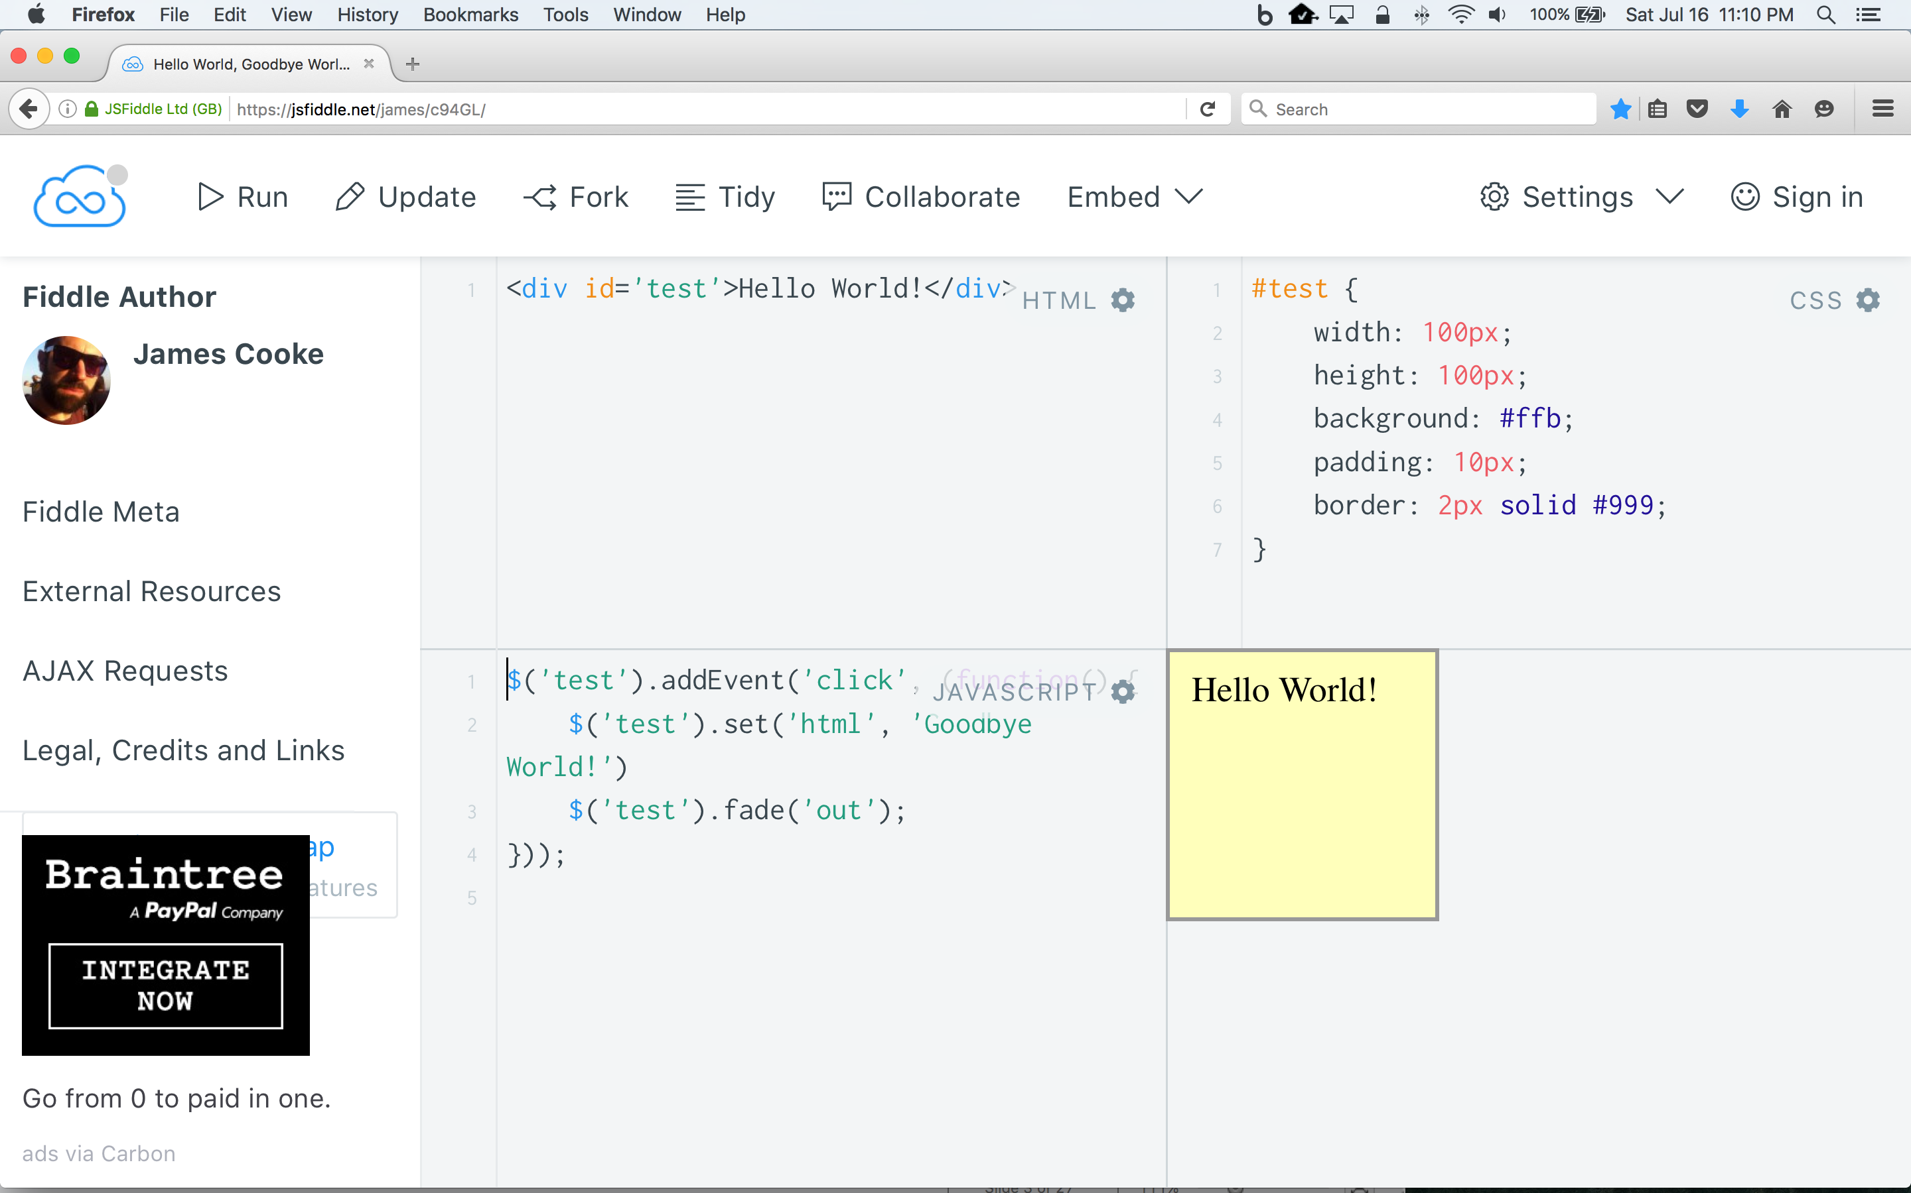

Slide 4
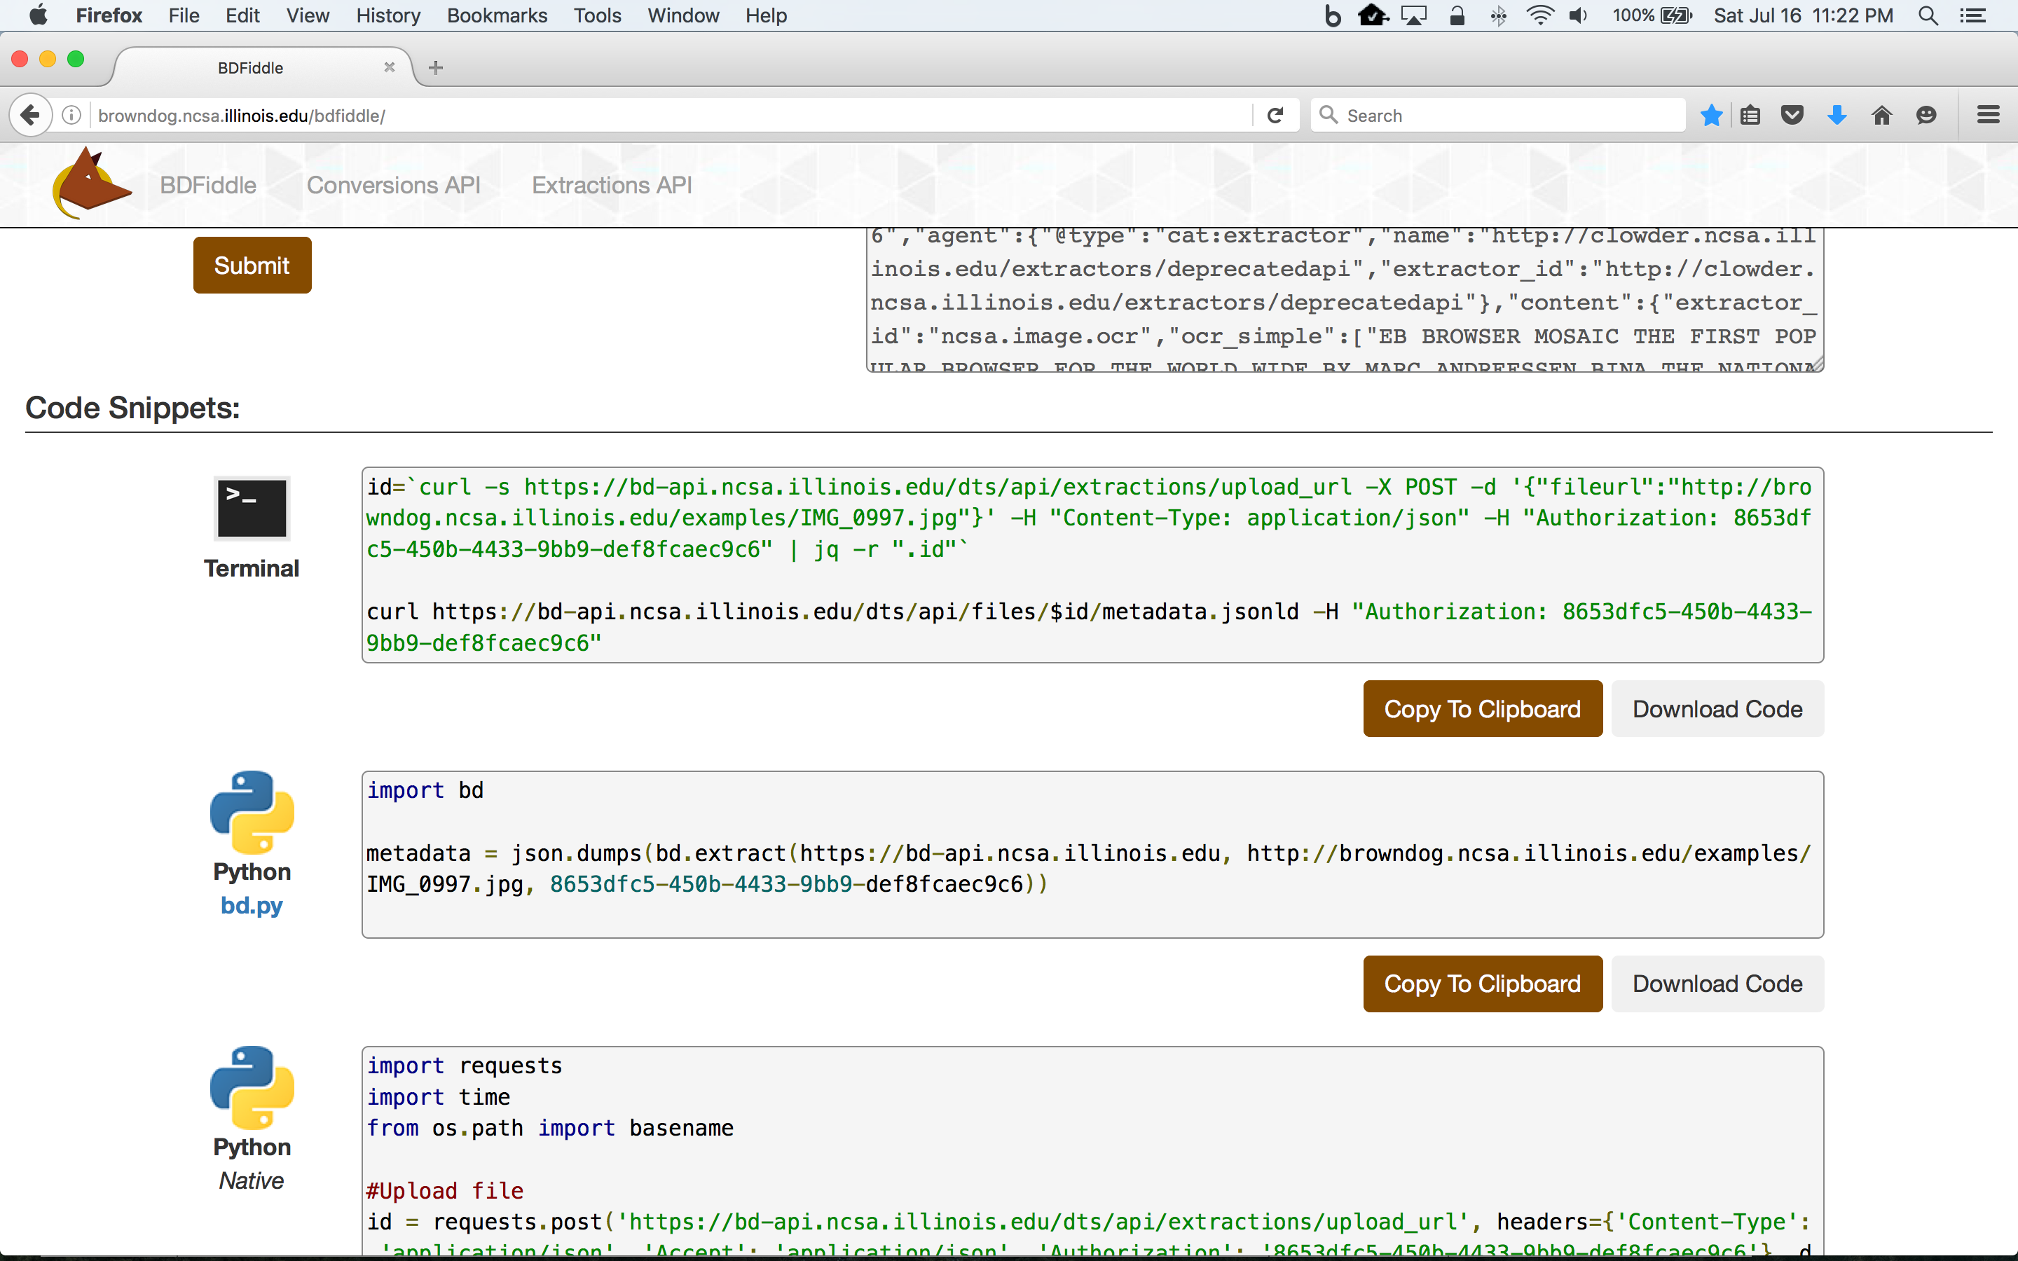
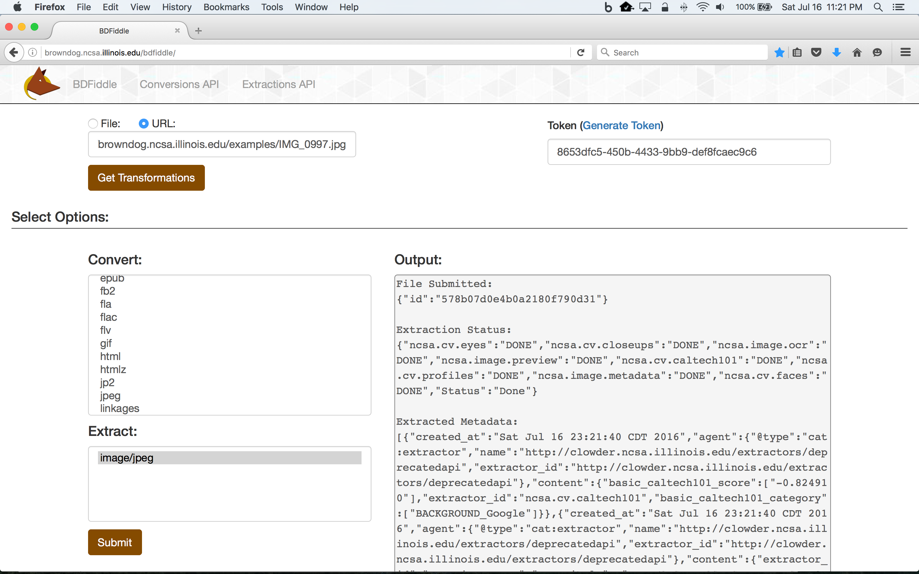
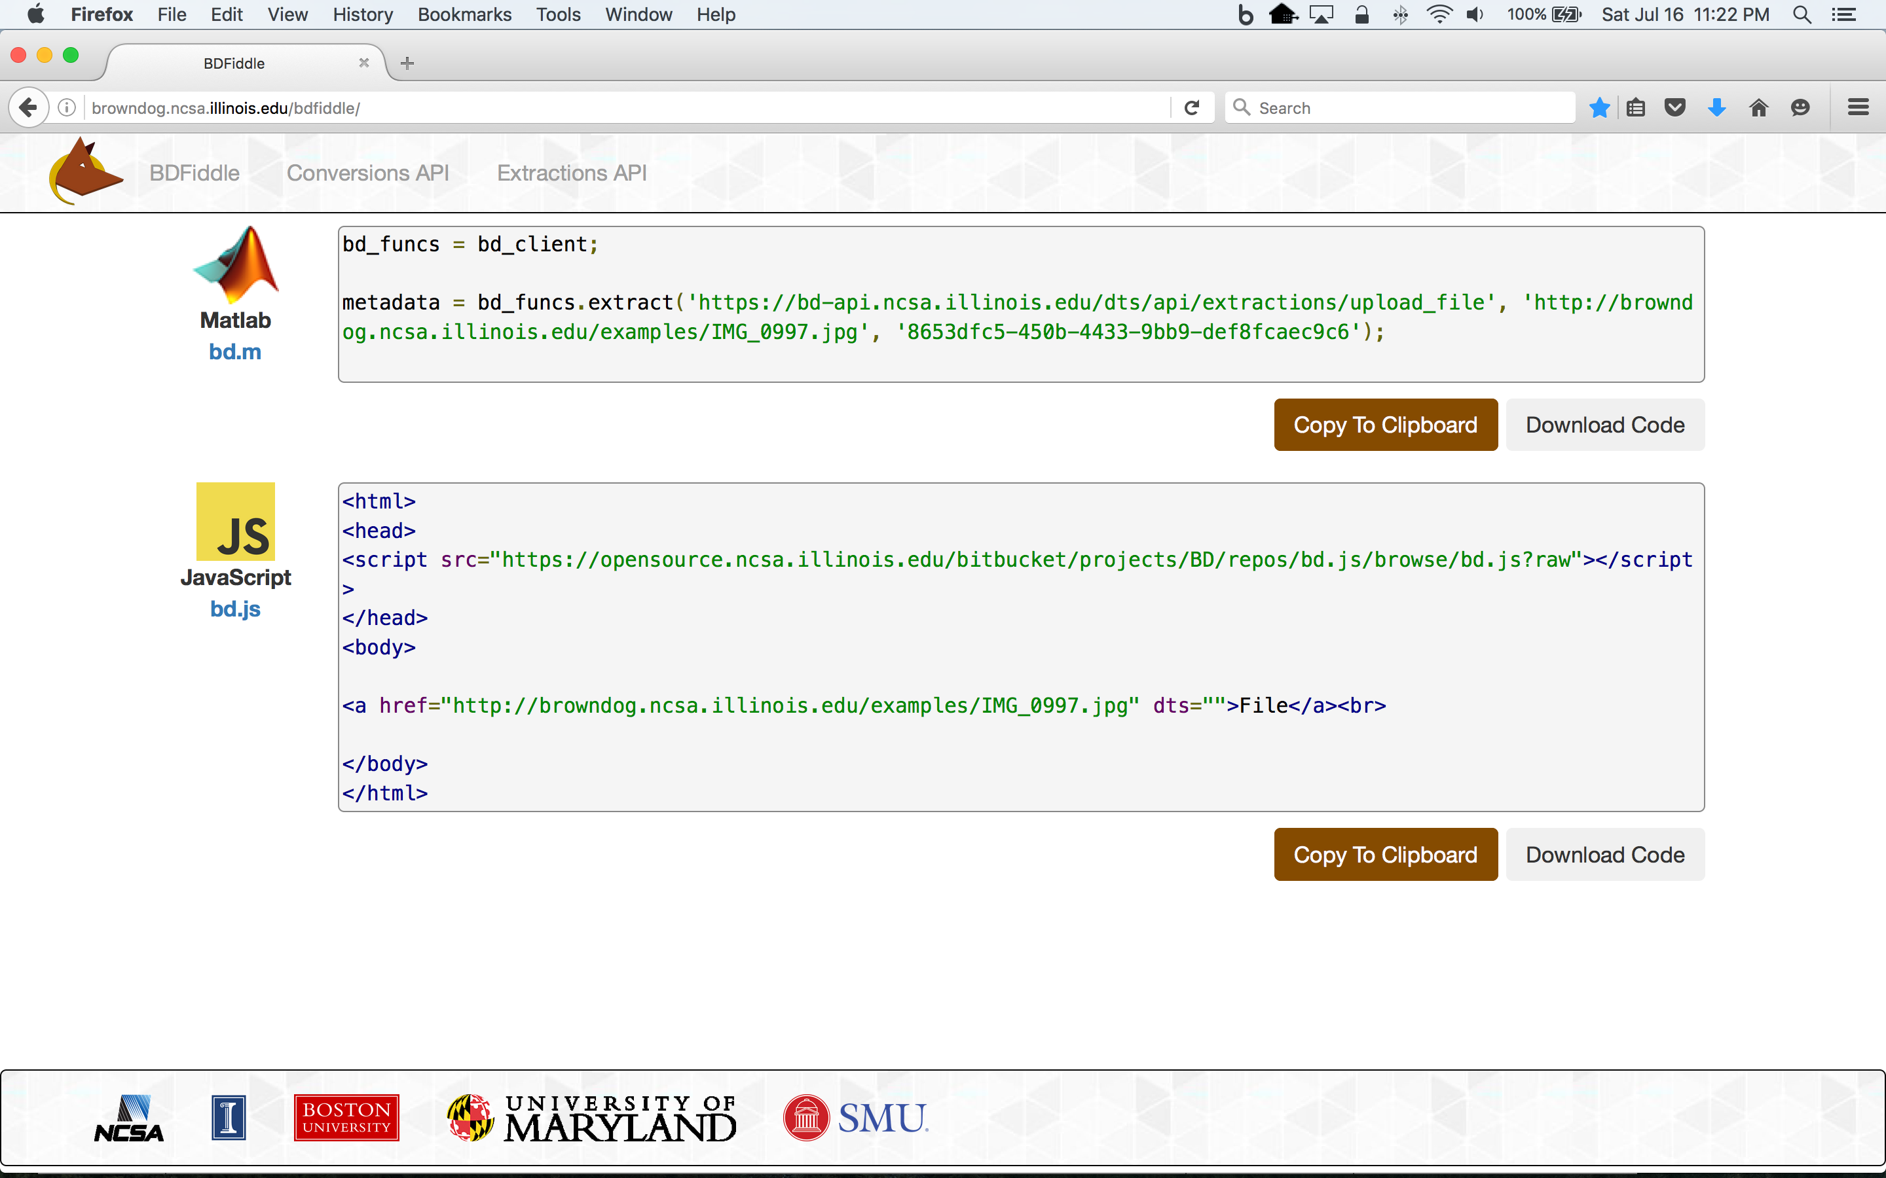
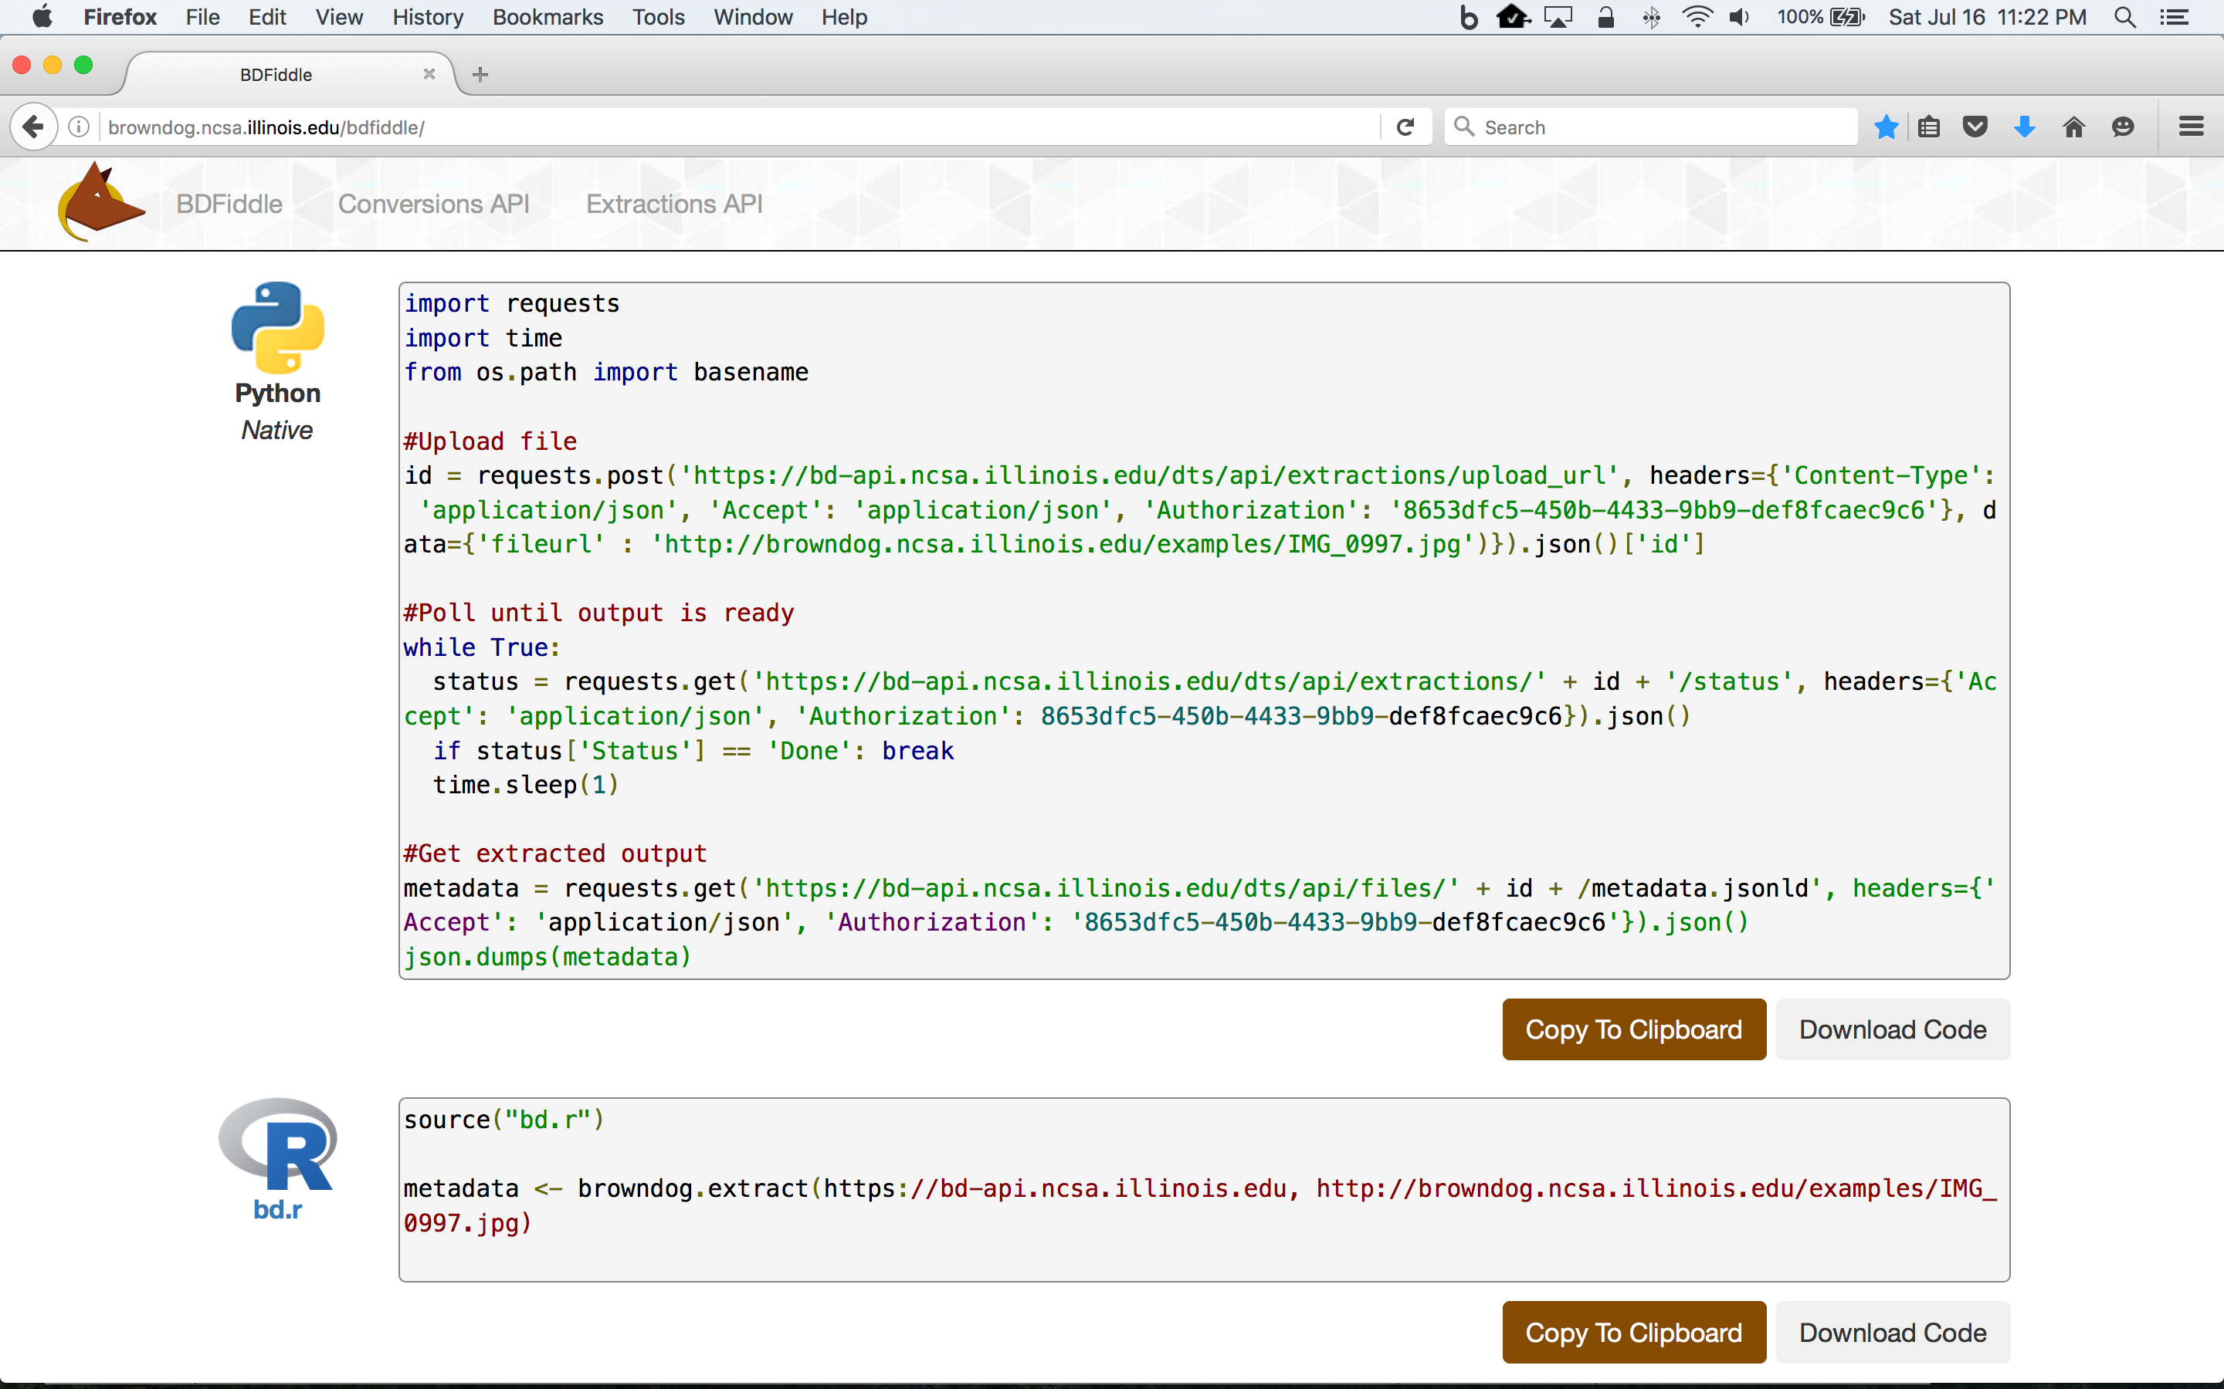

Slide 5
Brown Dog Architecture
Web Browser (BDFiddle)
Clients
(e.g. bdcli)
HTTP/HTTPS
RabbitMQ (Event Bus)
HTTP/HTTPS
Fence (API Gateway)
NGINX (Load balancer)
NGINX (Load balancer)
Polyglot
…
Polyglot
Clowder
Clowder
…
MongoDB
MongoDB (Data, Metadata)
Converter (Software Server)
Converter (Software Server)
Extractor
Extractor
…
…
Conversions
Extractions
Notes:
We show here the architecture of the Brown Dog services: i) The DTS is built on top of the Clowder framework which is a web-based content management system. Using the DTS REST API, a user can upload a file/dataset or url to a file to the DTS. This triggers specific extractors based on appropriate MIME types, for extraction of metadata, signatures or any derived product from the file’s content. Inside DTS, there is a distributed messaging bus, RabbitMQ, which reliably distribute and manage job execution by placing messages in a queue for each extractor, and removing them when job done. Extractors listens to the RabbitMQ for new messages for extraction. It saves all input files, dataset and outputs in MongoDB. Extractors can be written in any language as longs as it can communicate with RabbitMQ and Clowder REST interface via HTTP – Java, Python, Scala, C/C++. Extractors are deployed within distributed cloud environment.
Data Access Proxy, It is built on top of the Polyglot framework and provides REST API allowing users and applications to use its conversion capabilities. One of the key component is Software Server which hosts one or more applications. It uses light weight wrapper script to automate specific functionalities within the application and then provide access to it via a consistent REST API. Software Server listens a RabbitMQ bus for any conversion jobs and has a queue for each software it controls. DAP polyglot head node monitors the RabbitMQ bus and queries for all available Software Servers and the software’s input and output formats it supports. It constructs a Input/Output graph, finds the shortest conversion path between specific input and output format and allow SS to do the conversion.

Slide 6
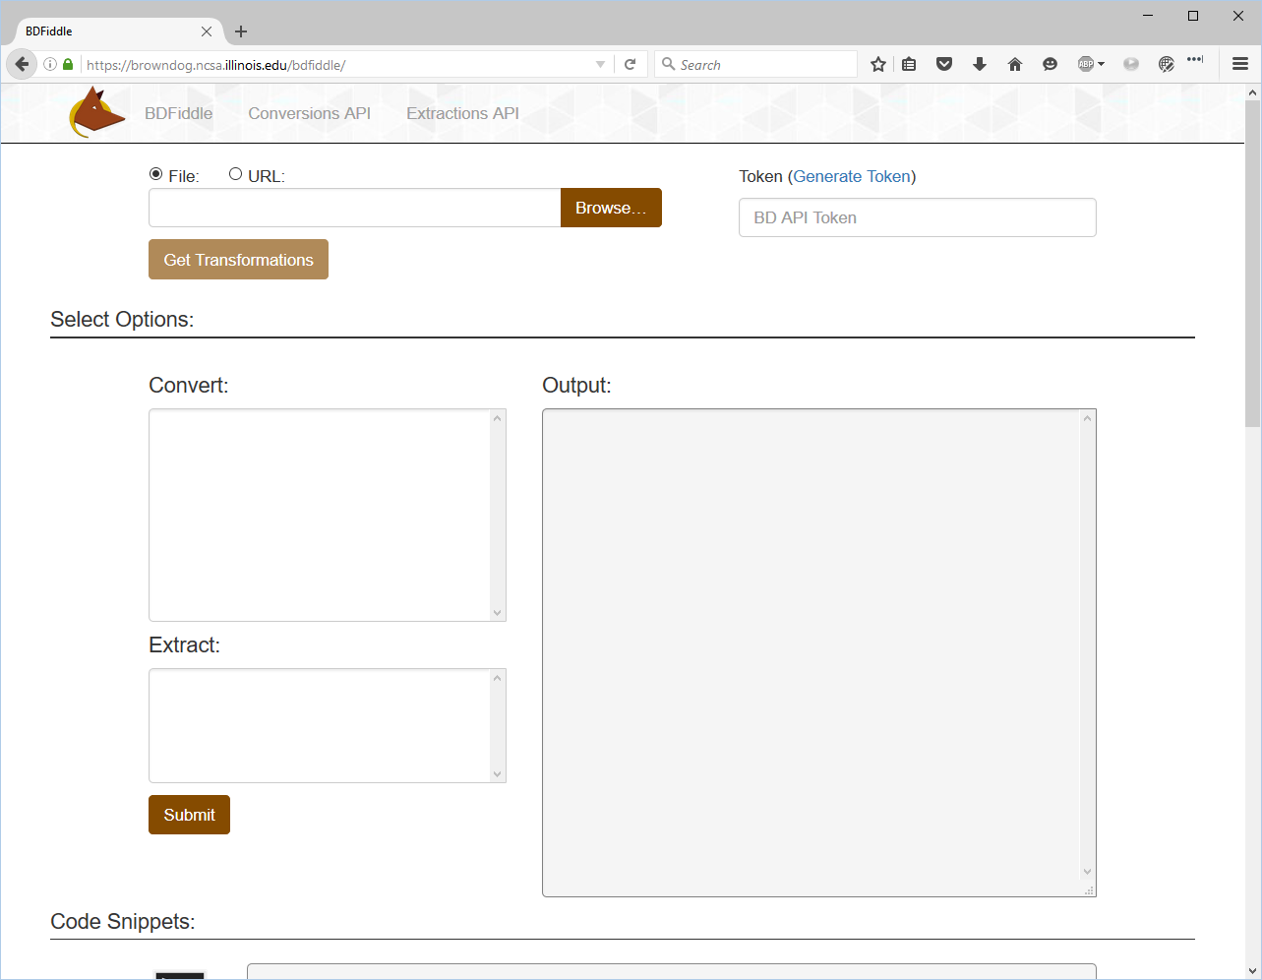
https://browndog.ncsa.Illinois.edu/bdfiddle

Slide 7
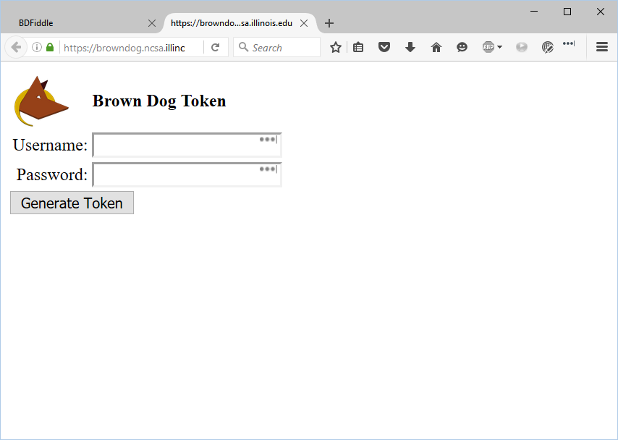
https://browndog.ncsa.Illinois.edu/bdfiddle

Slide 8
Service Key and Tokens
Using BDFiddle – “Generate Token” link
key_token.php in bdfiddle repository (https://opensource.ncsa.illinois.edu/bitbucket/projects/BD/repos/bdfiddle/browse/key_token.php)
Using BD Command Line Interface (python code)
Key_token.py in bdcli repository (https://opensource.ncsa.illinois.edu/bitbucket/projects/BD/repos/bdcli/browse/key_token.py)

Slide 9
Service Key and Tokens
Using cURL
Getting Key: Replace Username and Password with what you provided on the signup page
Token: {key} is the key you obtained from the first cURL command
Any browser extension for REST client
For example, Postman in Chrome browser
curl -X POST -H “Accept:application/json” https://bd-api.ncsa.Illinois.edu/keys -u username:password
curl -X POST -H “Accept:application/json” https://bd-api.ncsa.Illinois.edu/keys/{key}/tokens -u username:password

Slide 10
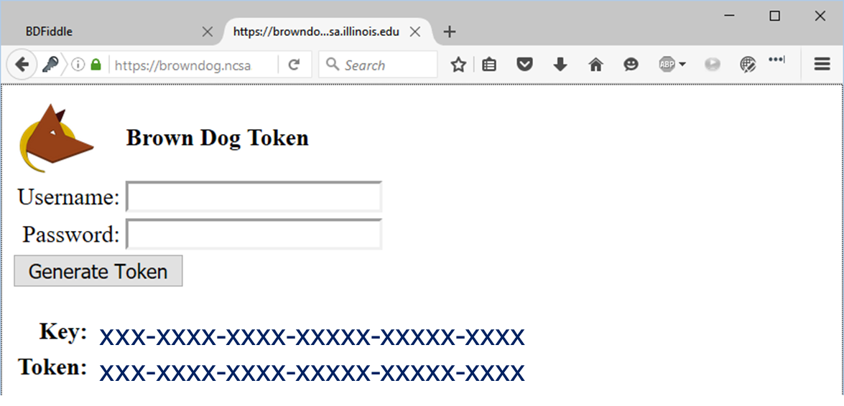
BDFiddle – Obtain Token
For this tutorial, you will use your browndog account you just sign up
Generates unique Key and Token, copy the Token and paste it into the Token field in BDFiddle

Slide 11
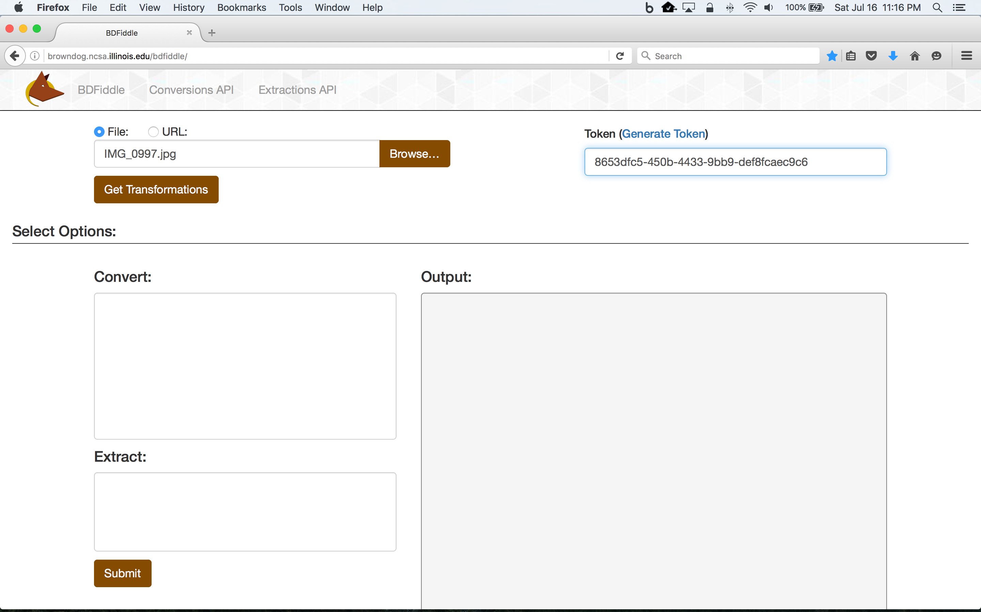

Slide 12
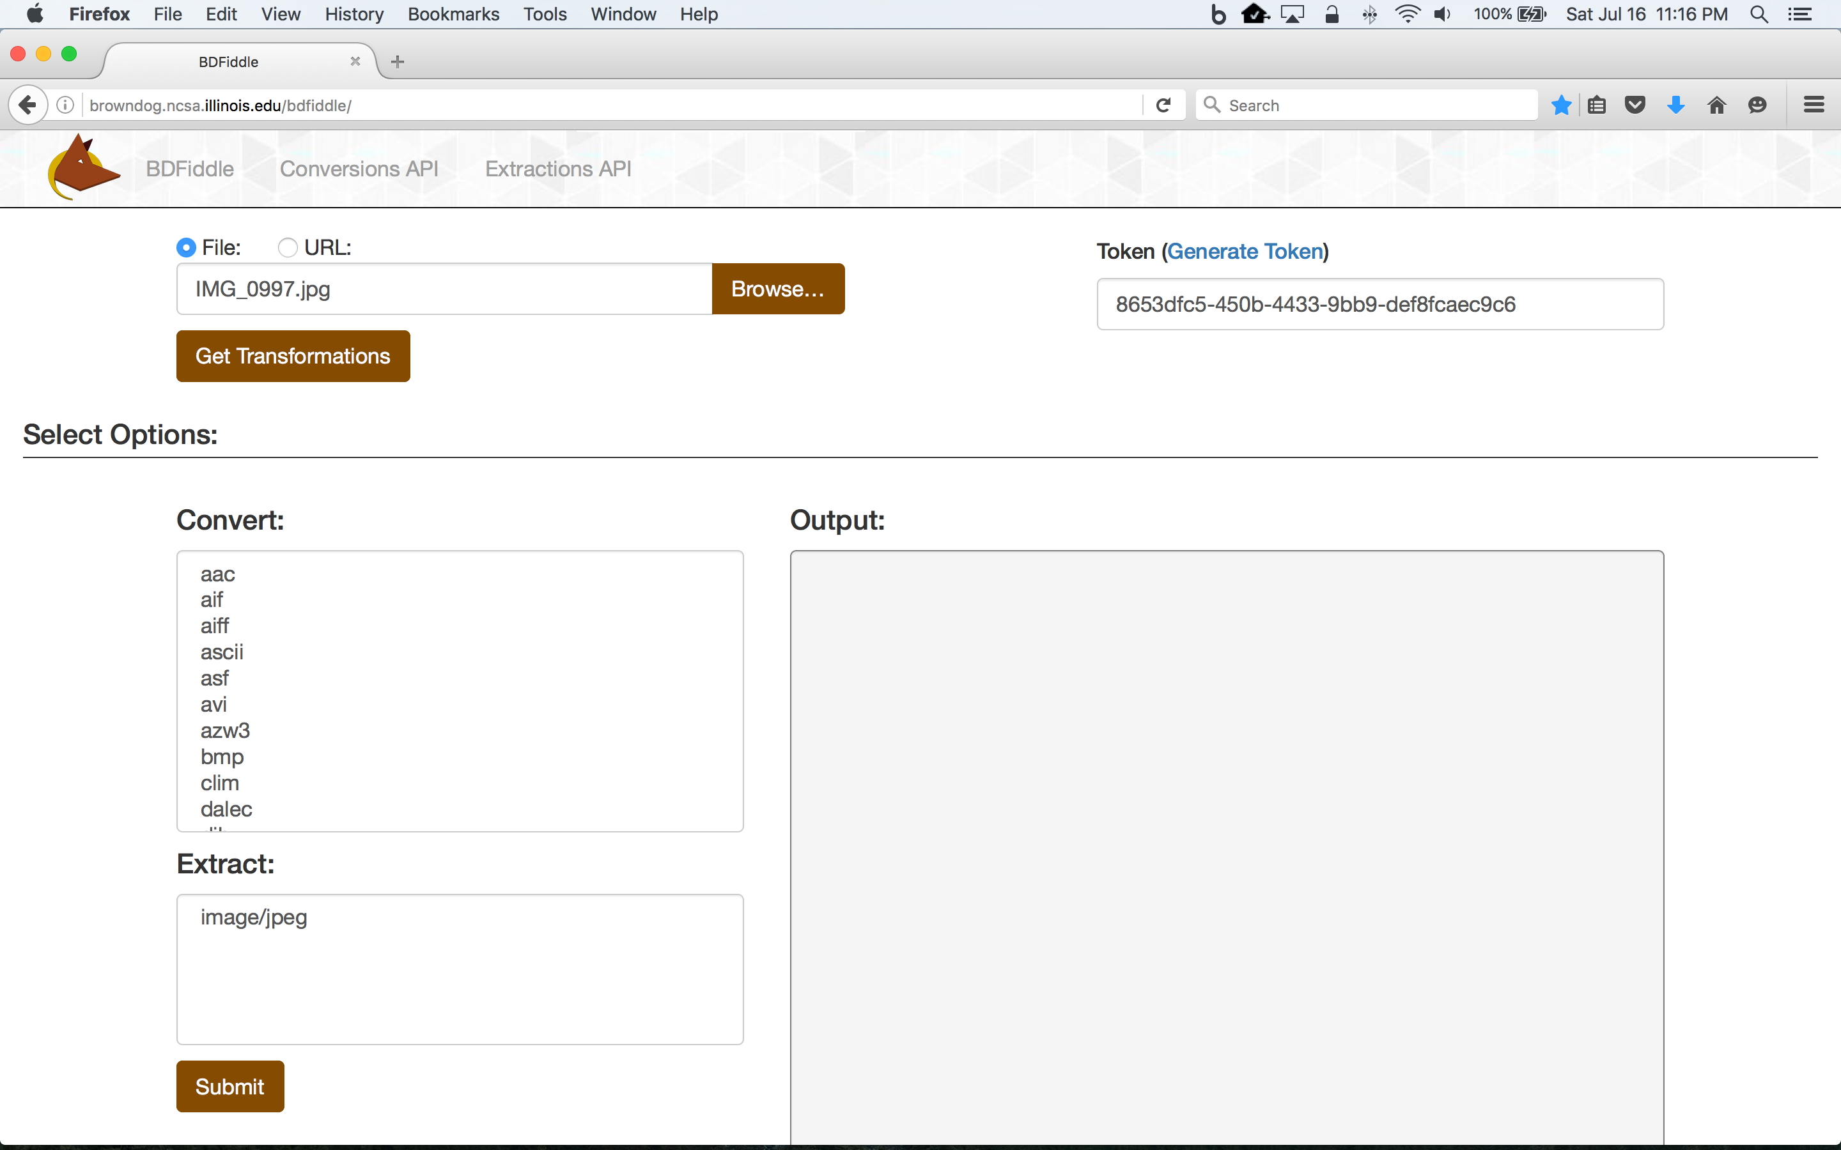

Slide 13
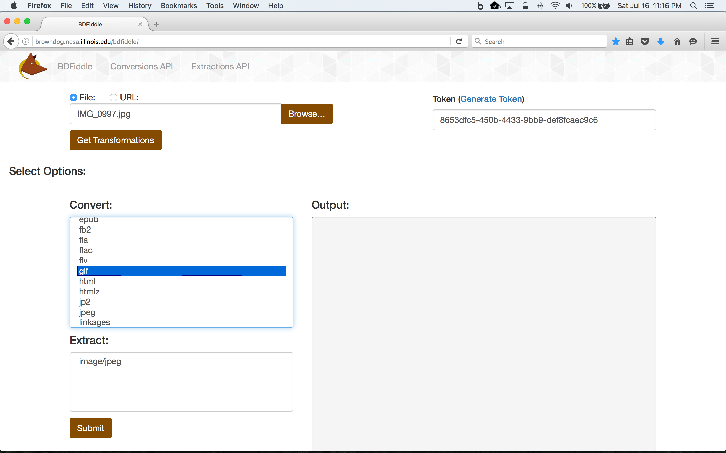

Slide 14
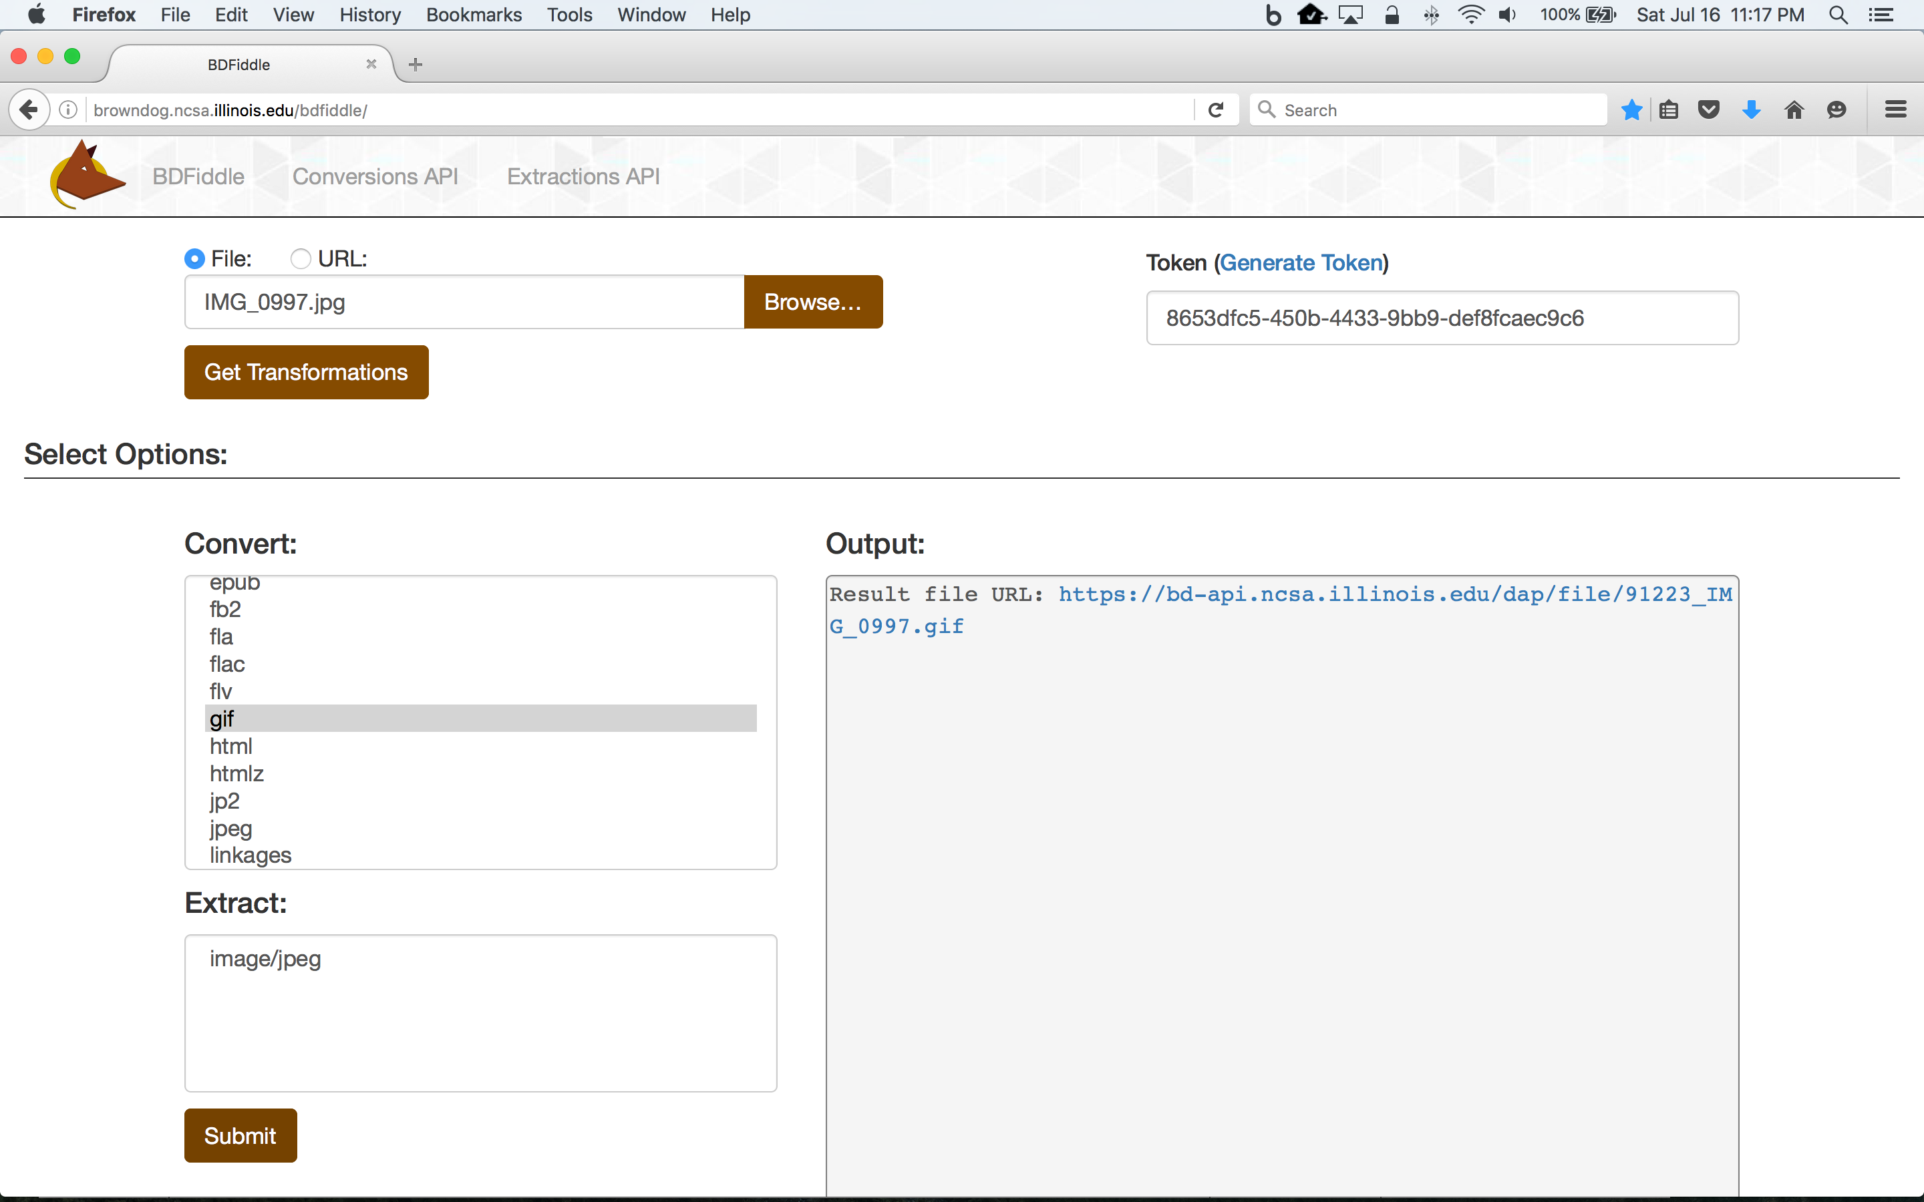

Slide 15
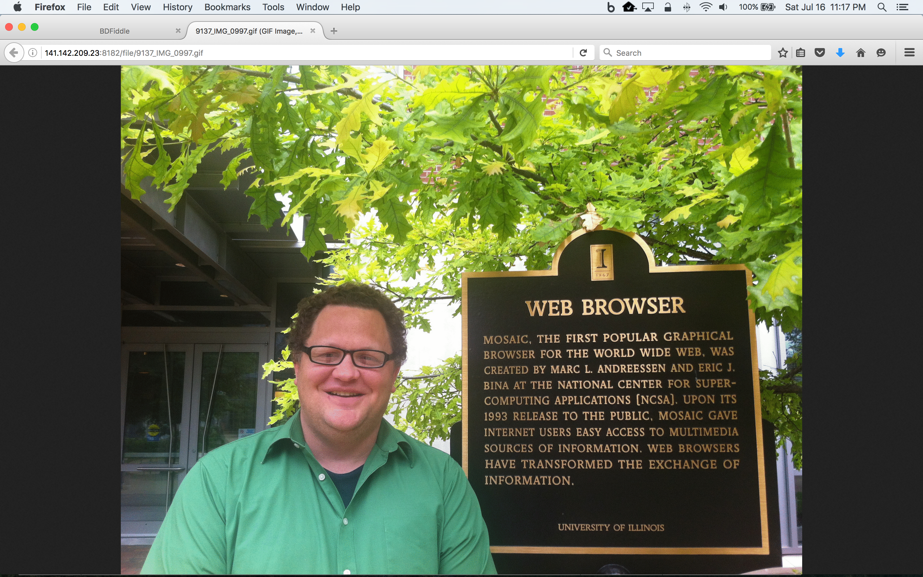

Slide 17
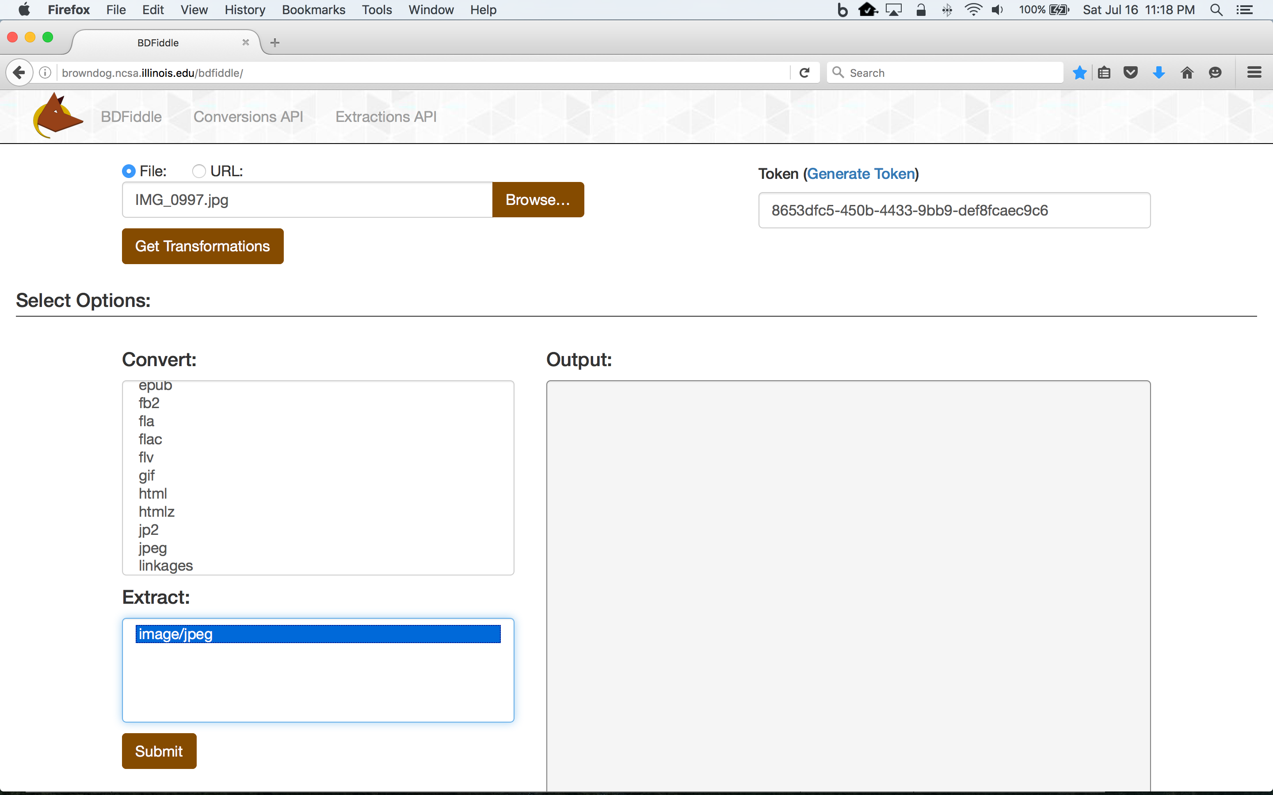

Slide 18
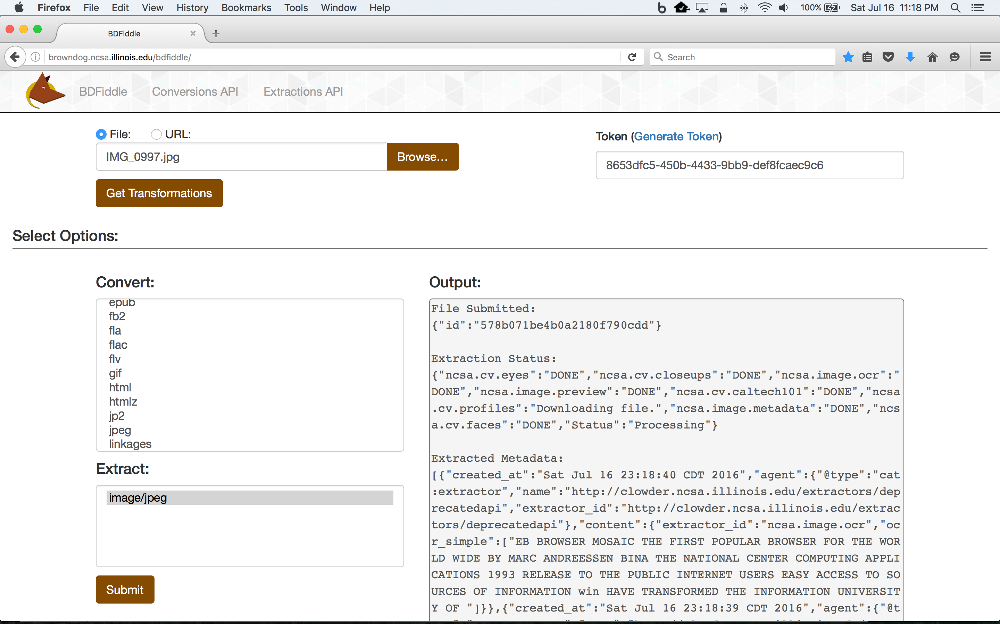

Slide 19
Code Snippets
BDFiddle provides code snippets that represent the equivalent API operations performed to obtain the results seen in todays demonstrations
Code snippets are currently available for the command line, Python, Matlab and R, and javascript
Try it! - BDFiddle provides a simple web interface for trying out the API and can help you get started using the Brown Dog API in your applications

Slide 20
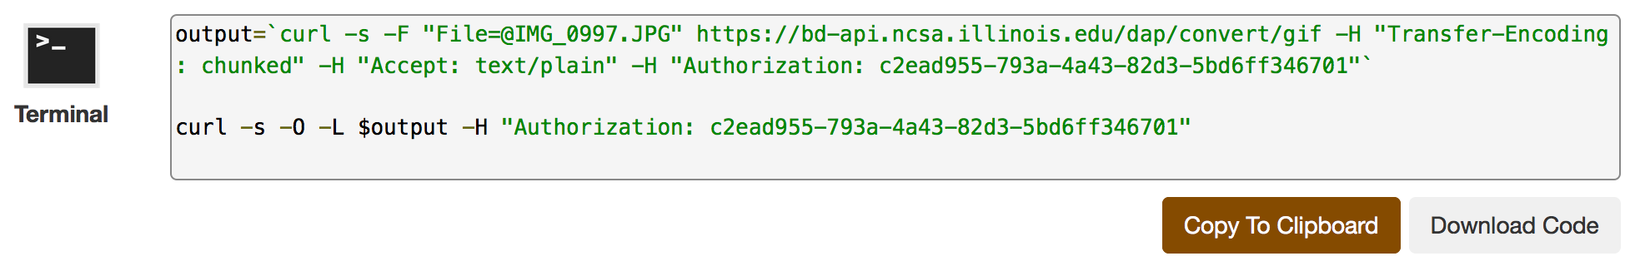
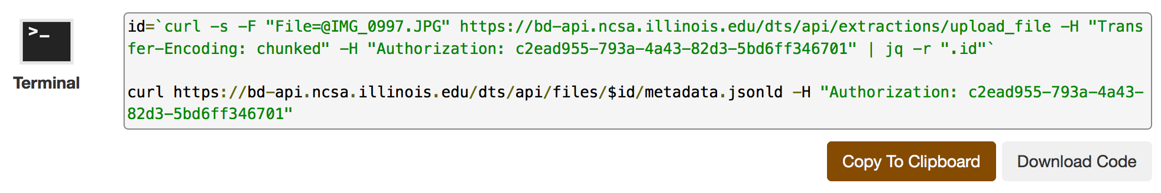
Code Snippets – Command Line

Slide 21
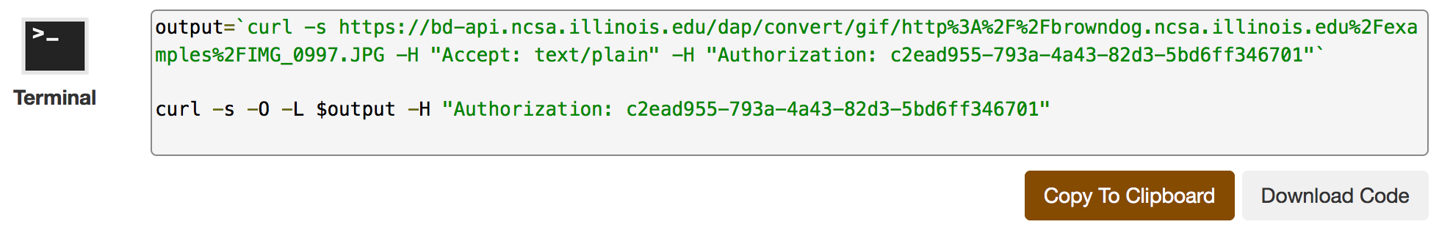
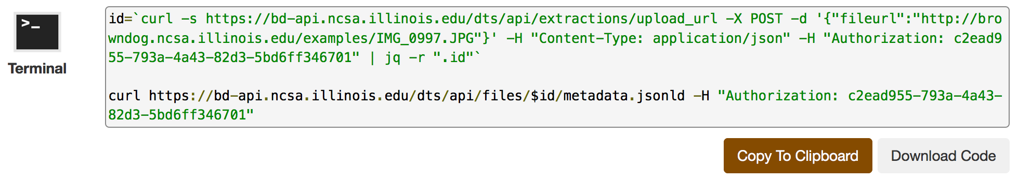
Code Snippets – Command Line

Slide 22
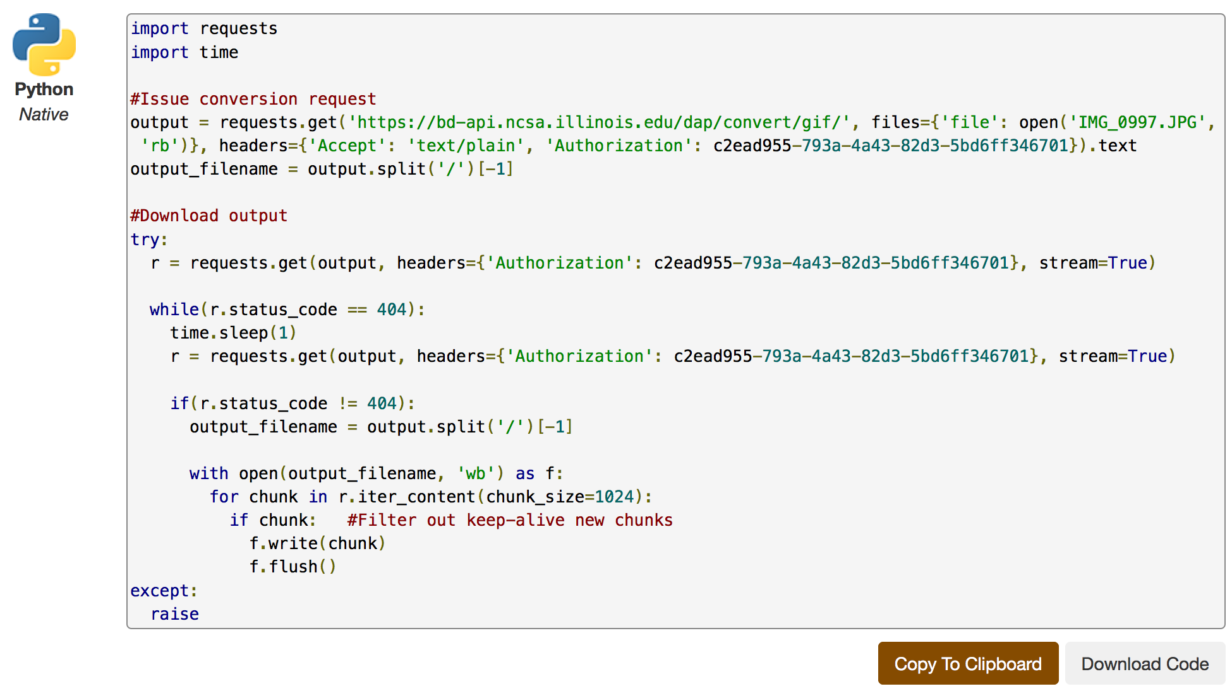
Code Snippets - Python

Slide 23
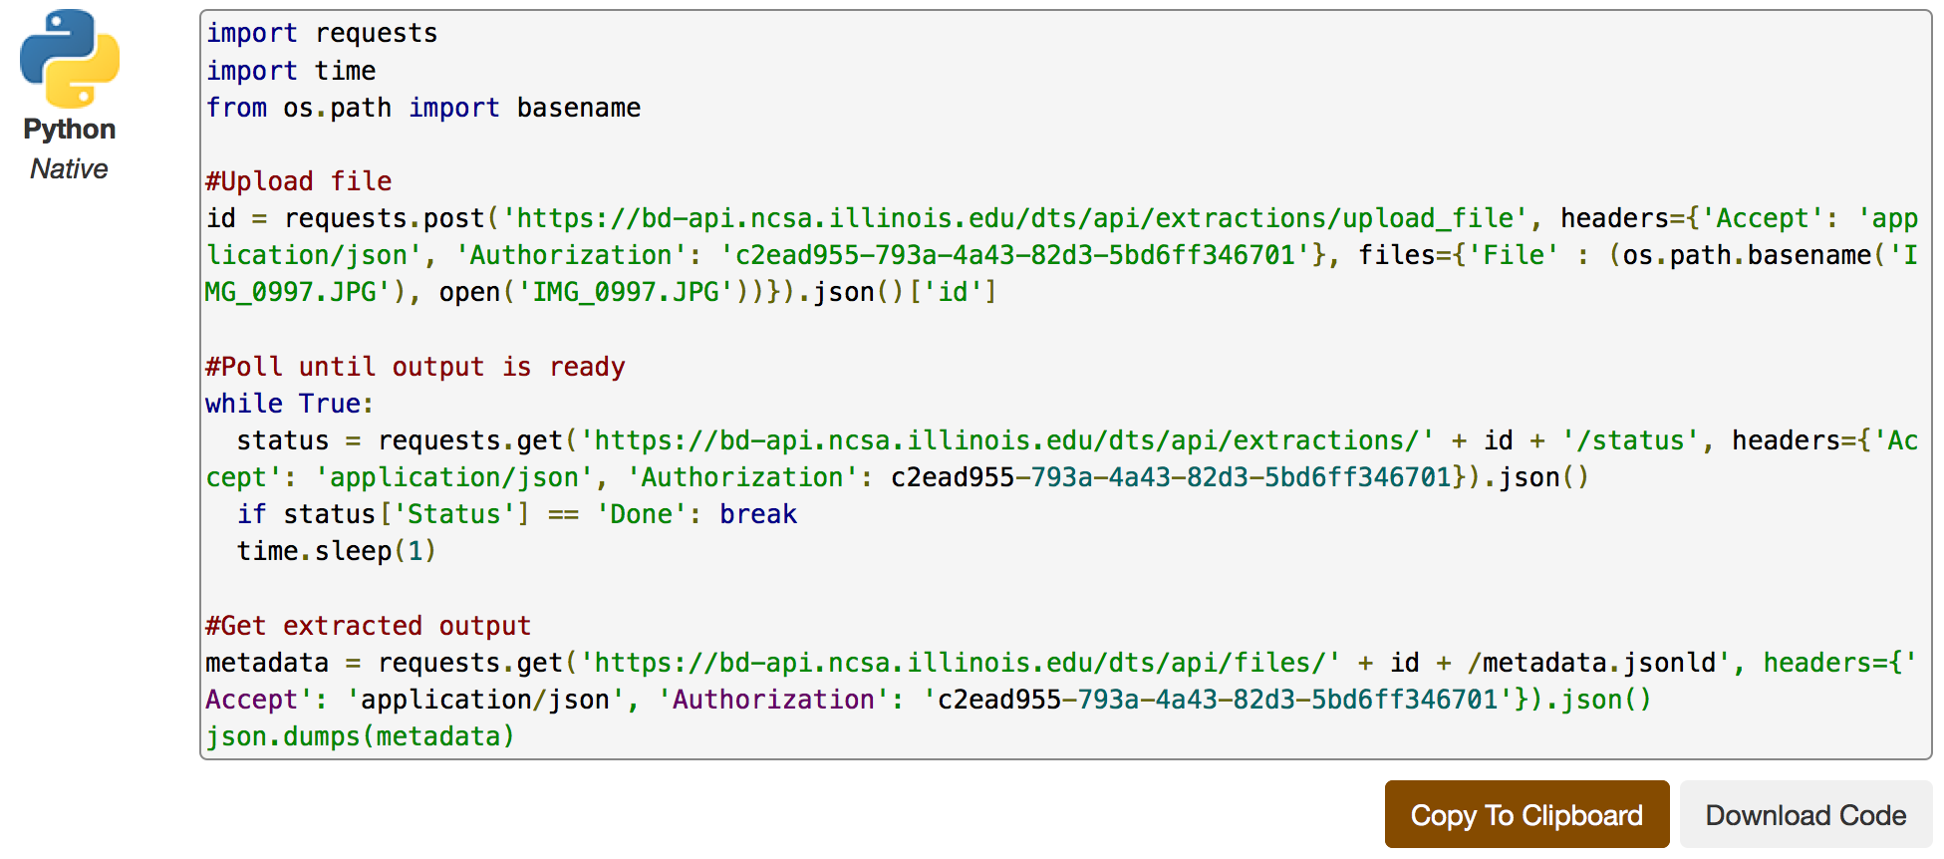
Code Snippets - Python

Slide 24
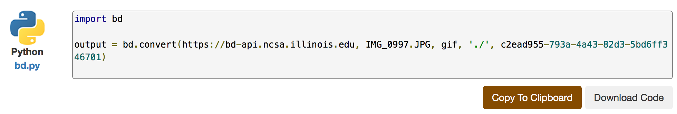
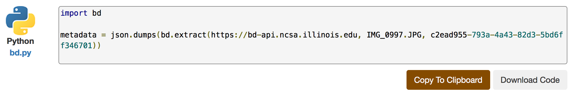
Code Snippets – Python

Slide 25
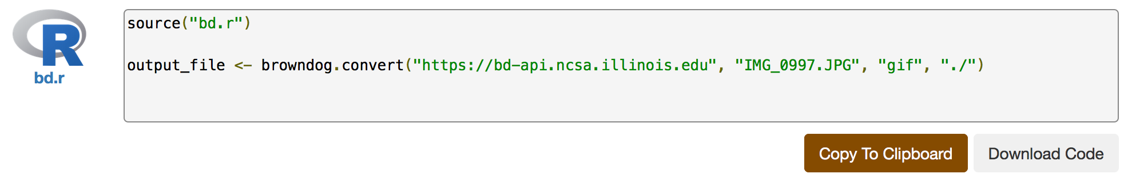
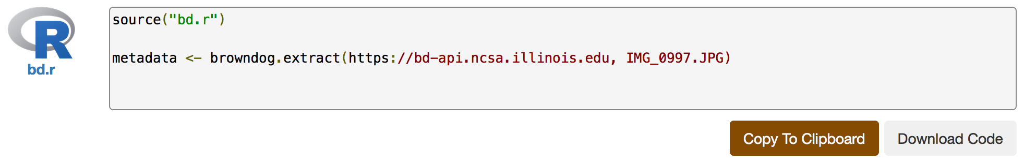
Code Snippets – R

Slide 26
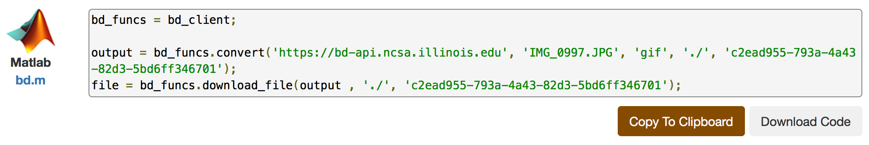
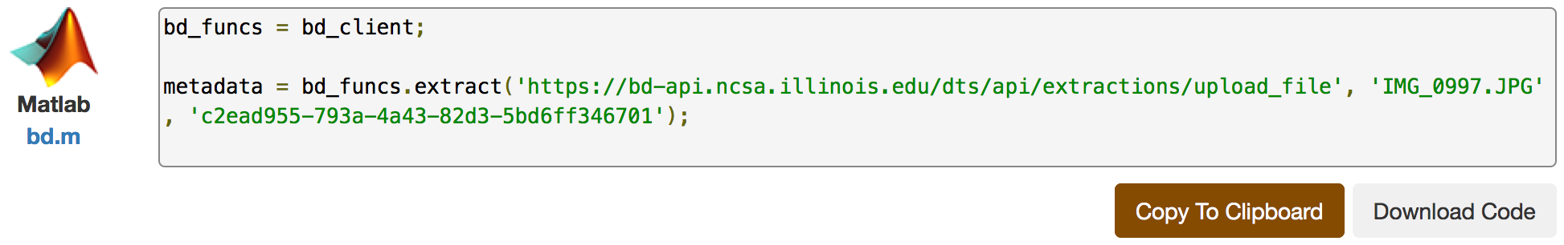
Code Snippets – Matlab

Slide 27
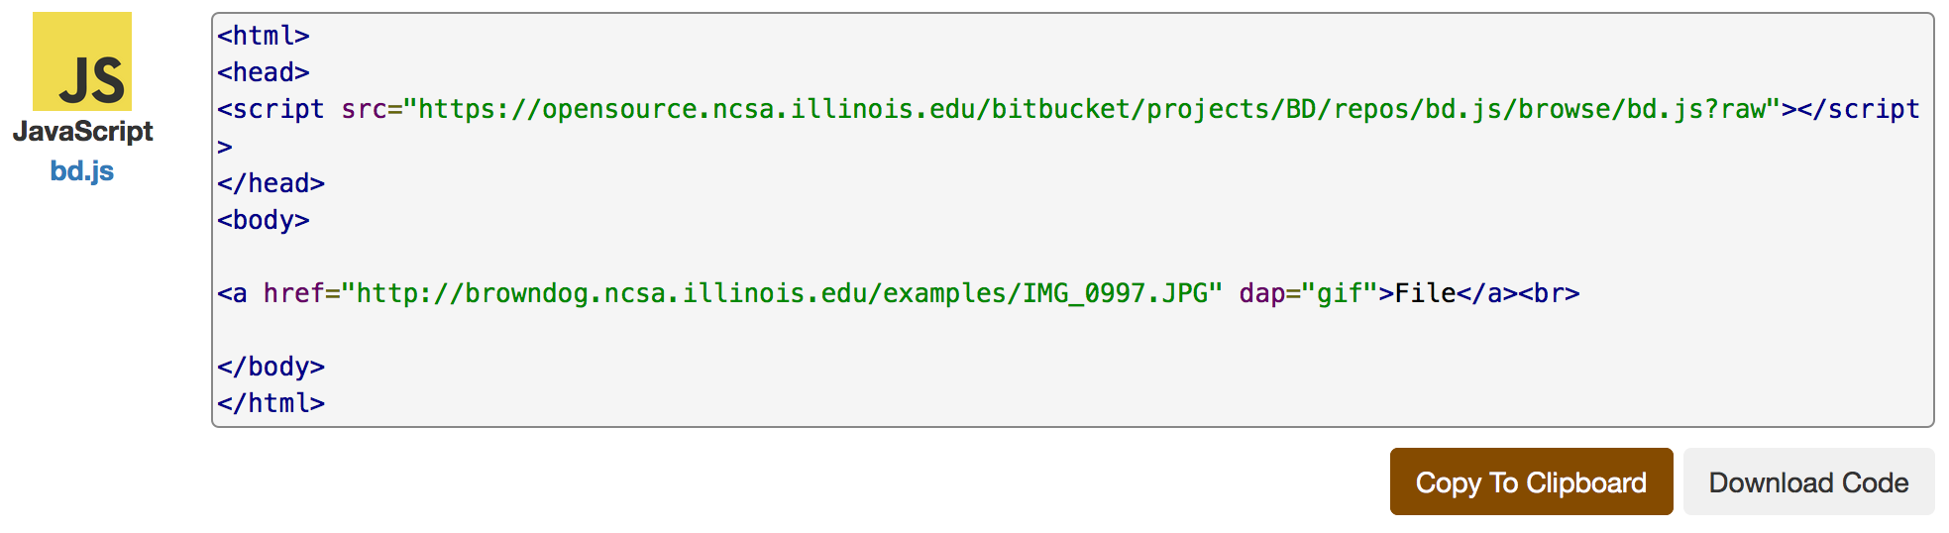
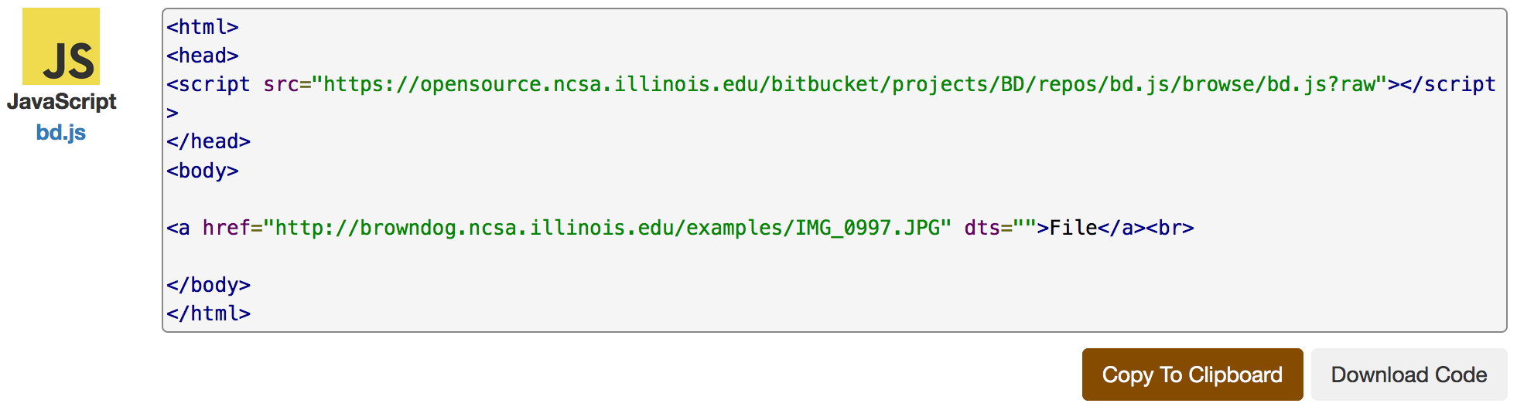
Code Snippets – Javascript

Slide 28
Hands-on Exercise
Try convert an image file to PDF
Either local file or online image
Try extract metadata from an image file with words on it to see how OCR works

